Slide 1
Misinformation Flow in Social Networks
Group -14

Slide 2
MEMBERS
ADITYA SHARMA
ANNAPOORANI. A
PRATIK HAWARE
SHLOK BANSAL
KSHITIJ GUPTA
KAMAL PHOOLWANI
SARTHAK VERMA
ALOK JAIN
ASHISH RAI
RAHUL KATYAL

Slide 3
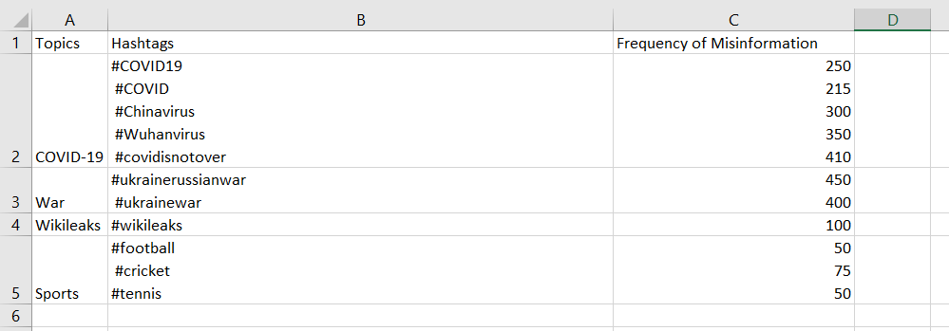

Slide 4
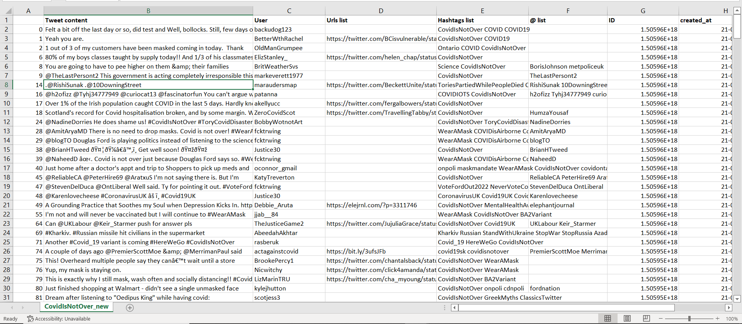

Slide 5
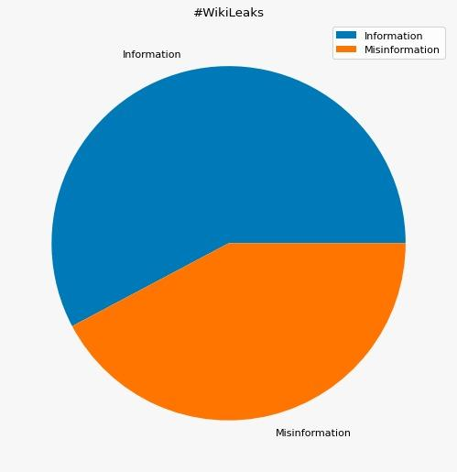
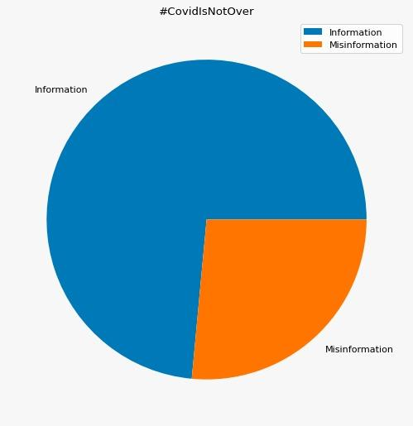

Slide 6
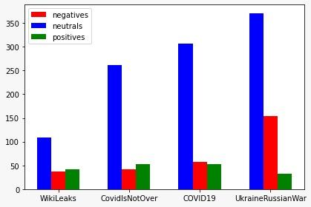

Slide 7
PIPELINE
1
2
3
4
Collection
Filtering
Network Analysis
Content Analysis
Collecting tweets related to a certain topic via scraping or API
Tweets that can be seen as valid misinformation tweets for our purposes are filtered out
Analyse diffusion of information in network structure
Use sentiment analysis, topic analysis and clustering . Then use GLM for to examine the differences in diffusion characteristics

Slide 8
Labeling Tweets As Misinformation
A list of trusted handles is maintained for initial misinformation validation.
If the tweet has cited to any of the sites or handle available in the trusted list then the information is deemed to be a valid information.
If not, sentiment analysis is done. Neutral sentiment indicates valid information, strong sentiments indicate misinformation possibility

Slide 9
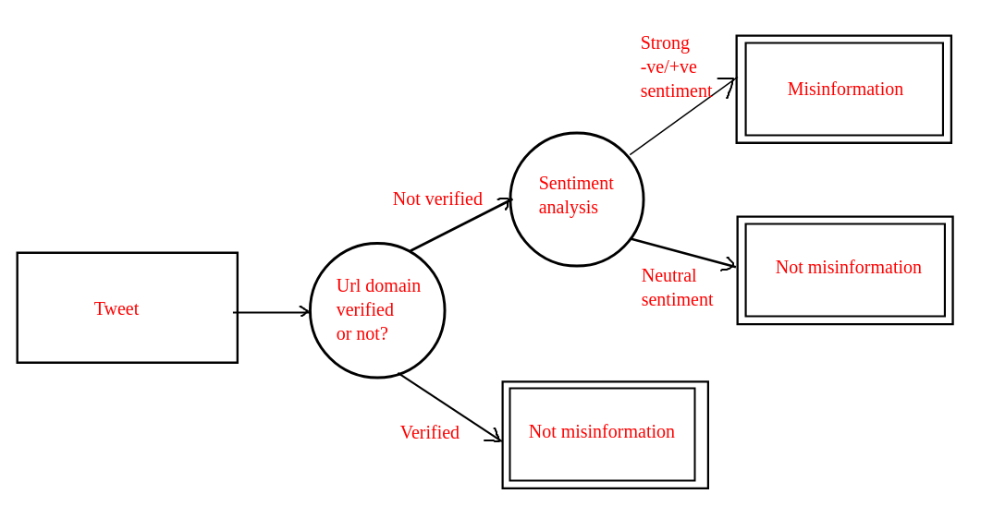
Labeling Tweets As Misinformation (Pt.2)

Slide 10
T - Test
The T-Test or the Student’s test is used to reject a null-hypothesis or not reject it.
We will be using the independent T-Test to determine the diffusion characteristics and draw a comparison, showing that there is a difference in the tweets, likes or comments between the misinformation and the true information.
T-value = (difference between group means)/(variability between the groups)
The factors like number of tweets, p-value, degree of freedom, mean, variance, skewness and kurtosis can help us understand the spread of diffusion of misinformation and analyse the characteristics of such networks, and the properties of true and misinformation.

Slide 11
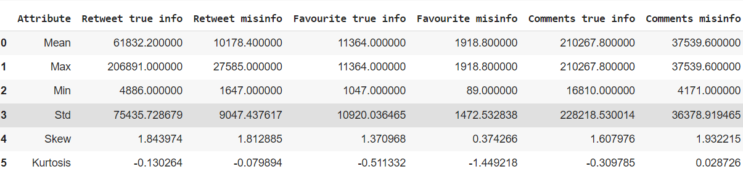
Formula: t-val =difference between the means of group/ variability of the groups
Null hypothesis: There is no significant statistical difference between the retweets, favourites or comments between true and misinformation.
Observations: The t-test gives t-values 1.52, 1.92 and 1.67 for retweets, favourites and comments. The number of degrees of freedom we obtained is 8 and on taking a significance level of 5% as a one-tailed test (p=0.05). We find our critical value is 1.86. Thus, our t-value is greater than our critical value in the number of favourites, so we can reject our null hypothesis for favourites and accept it for the other two cases.

Slide 12
Conclusion: The diffusion of misinformation in favourites is statistically much significant from the diffusion of true information in favourites.
Analysis: The Independent Sampled T-test was performed. The increased kurtosis indicate that there is increase in the tail data greater than normal distribution.
The lower value shows lower values in tail data. Thus increased kurtosis indicates extreme data, which we see only in the comments.
Skewness has all values positive, this shows that our bell curve is distorted to the right. So there is a distortion of data.

Slide 13
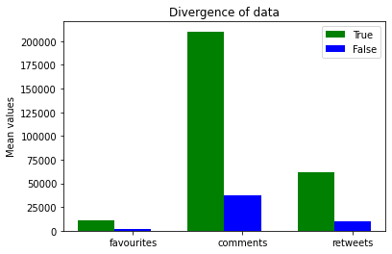
Divergence is data is observed by this graph. We see that the maximum divergence occurs because of the difference in the means of true and false information, especially in the number of comments.
So diffusion index is higher in retweets and comments when compared to favourites.
We see that overall, true information diffuses more that mis-information.

Slide 14
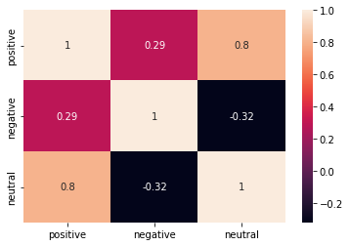
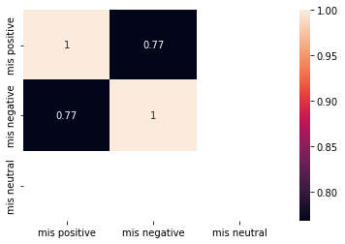
Correlation
The correlation graph is made on the various sentiments (positive,negative and neutral) of the users. We see that a positive correlation indicates that information is more likely to be retweeted.
A negative correlation is lesser retweeted. This analysis gives the relation between veracity and network diffusion characteristics. We see that there is no neutral misinformation in our dataset.

Slide 15
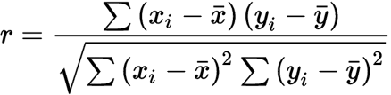
We use the Pearson’s coefficient as a metric of correlation. It uses covariance and gives the relationship between the variables.
The closer the relationship, the stronger the veracity and network diffusion of the information.
Pearson’s Point Binomial Correlation Coefficient is used when a variable is dichotomous and this is a special case of the normal Pearson’s coefficient.
Formula:

Slide 16
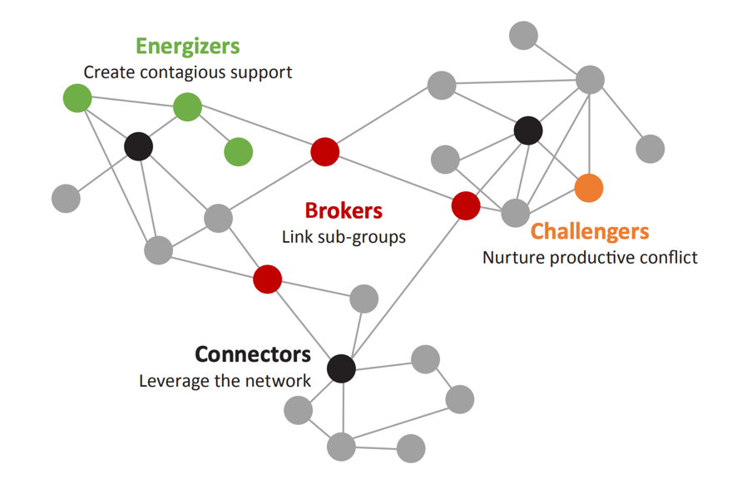
Network Analysis
Network Analysis helps us in deep understanding the structure of a relationship in social networks, a structure or process of change in natural phenomenons, or even the analysis of biological systems of organisms.
Use cases:
Identifying the most influential person/people in a group
Defining characteristics of groups of users
Prediction of suitable items for users

Slide 17
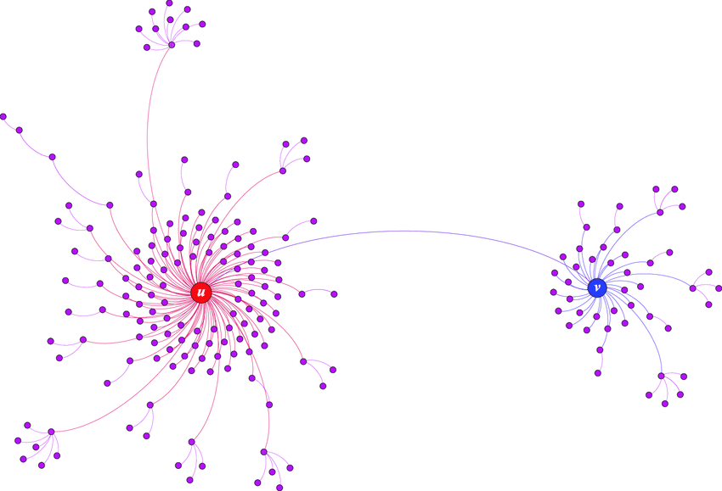
Diffusion Networks
Network diffusion captures the underlying mechanism of how events propagate throughout a complex network.
Questions in case of misinformation:
How fast will it spread?
How will the system as a whole react?
What are the hubs in the network that are more connected and therefore more important than others

Slide 18
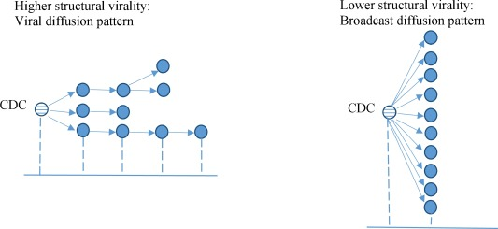
Diffusion Characteristics For Misinformation Tweets
No. of Likes
No. of Retweets
No. of Comments
Range of retweet (Timestamp)
The Structural Virality ( Goel. et al., 2016)

Slide 19
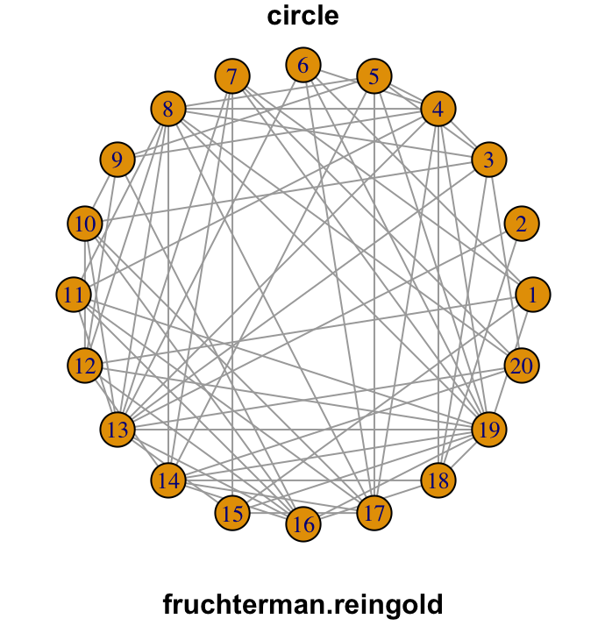
Diffusion Network Challenges
We’ll be using Fruchterman Reingold Layout for graph of forwarding network. Reasons:
Shows spread/flow of information between nodes
Equidistant nodes mean clear edges between nodes.
Different classes of nodes and their edges can be compared more clearly
Individual tweets would be used as nodes where user engagement is used as a metric to highlight certain tweets
Retweeting relationships would be treated as edges in the network.

Slide 20
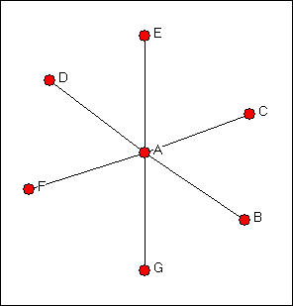
Diffusion Network Challenges
Since API only shows original tweet for retweeted tweets. The network would form star topologies and may not be able to accurately show diffusion structure.
To show diffusion better distance from centre would be proportional to time of tweet.
All intermediary retweets would be considered as nodes in path.
We’ll use Weighted Softmax Function to Resolve retweet paths

Slide 21
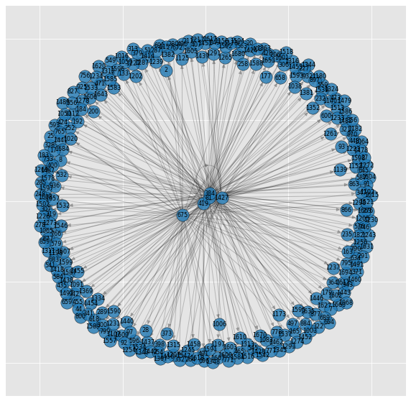
Building Retweet Cascades

Slide 22
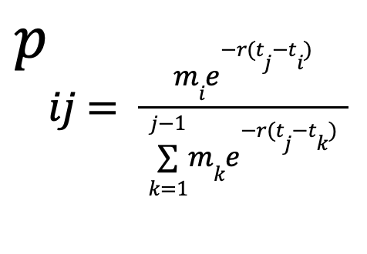
Building Retweet Cascades
Probability of Retweeting Drop Exponentially with Time Difference
Users Prefer Locally Influential users

Slide 23
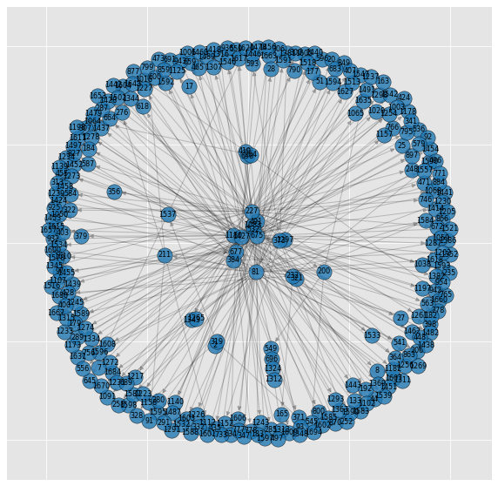
Building Retweet Cascades

Slide 24
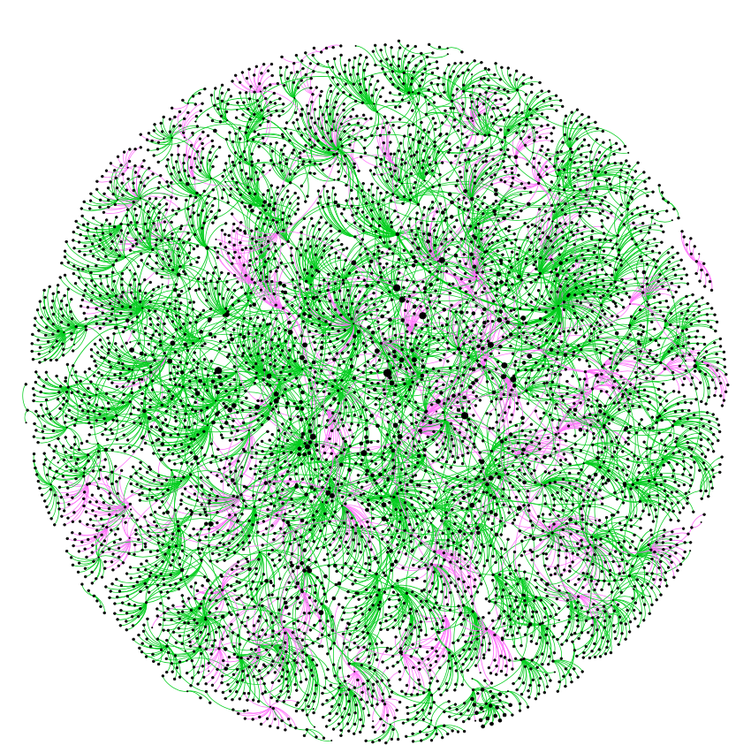
Misinformation vs True Information
Misinformation
True Information

Slide 25
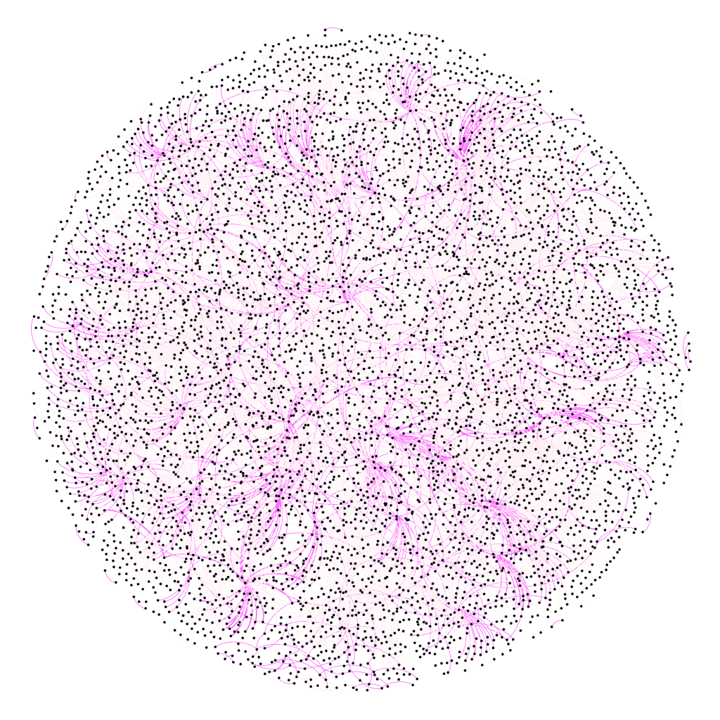
Misinformation vs True Information
Misinformation
True Information

Slide 26
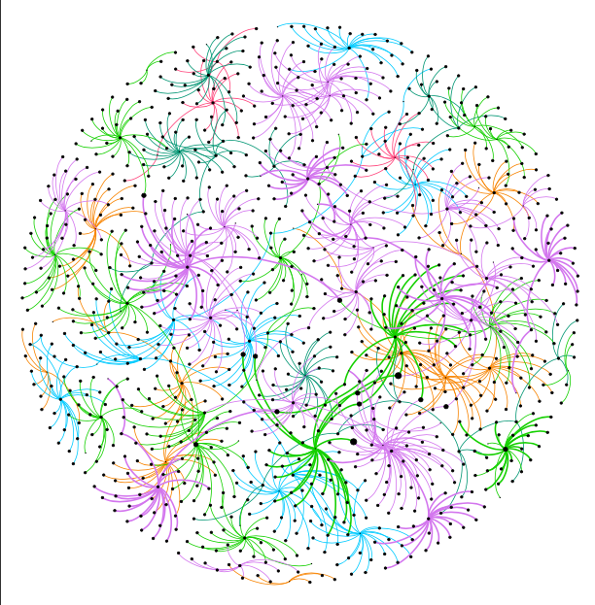
Misinformation By Topics
Avg. Cascades
Religion 128
Health 97
Celebrities 44
War 73
Politics 108
Crisis 83

Slide 27
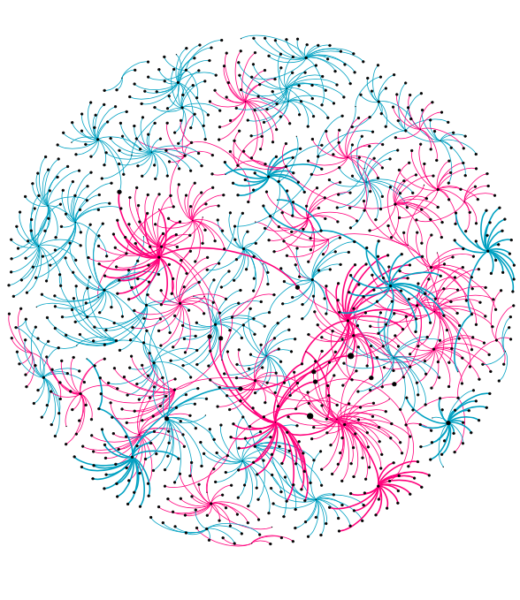
Misinformation By Sentiment
Negative
Positive

Slide 28
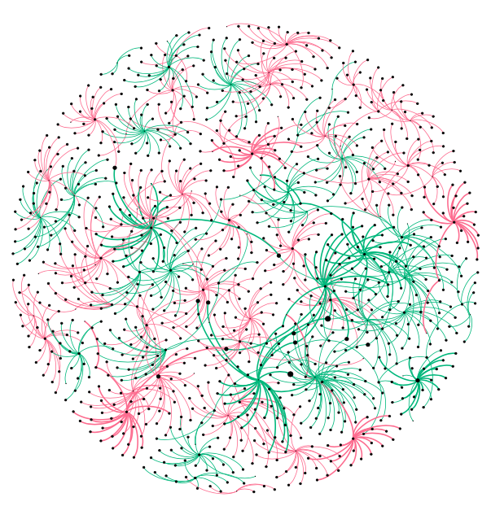
Misinformation By Media Presence
Media Present
Not Present

Slide 29
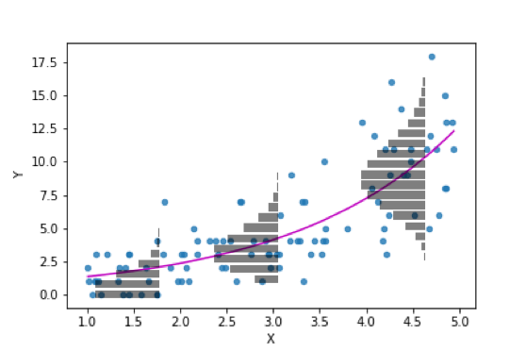
General linear Model
The General Linear Model (GLM) is a useful framework for comparing how several variables affect different continuous variables.
It is mainly used for model specification. It helps us to arrive at the exact equation that will most accurately summarize the data, in other words it allows us to summarise the research outcomes.
It is important as incorporation of the wrong model will introduces biases and will not be able to describe the dataset accurately.
We will use the General Linear Model (GLM) to examine the differences in diffusion characteristics between different categories of topics in true information and misinformation.

Slide 30
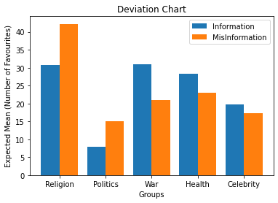
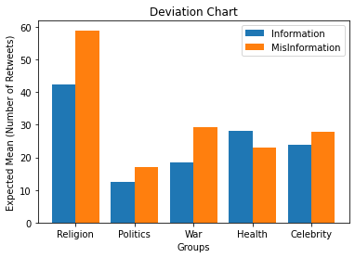
General linear Model
Based on expected number of favorites is more likely to be spreading misinformation than information.
Tweet classified as belonging to health, based on number of favorites is more likely to be spreading information rather than misinformation.
The number of retweets and comments, the diffusion spread is varied and means are at different levels for each category.
Figure : Mean Number of favorites
Figure : Mean Number of Retweets

Slide 31
THANK YOU

Slide 32
References:
https://www.researchgate.net/figure/Diffusion-network-examples-The-network-visualization-in-a-shows-that-rumors-involve-a_fig2_312367197
https://www.ncbi.nlm.nih.gov/pmc/articles/PMC6231818/
https://www.sciencedirect.com/science/article/pii/S0747563218303613#bib19
https://www.ncbi.nlm.nih.gov/pmc/articles/PMC7123536/

